Slide 1
RANSAC
BEP2021

Slide 2
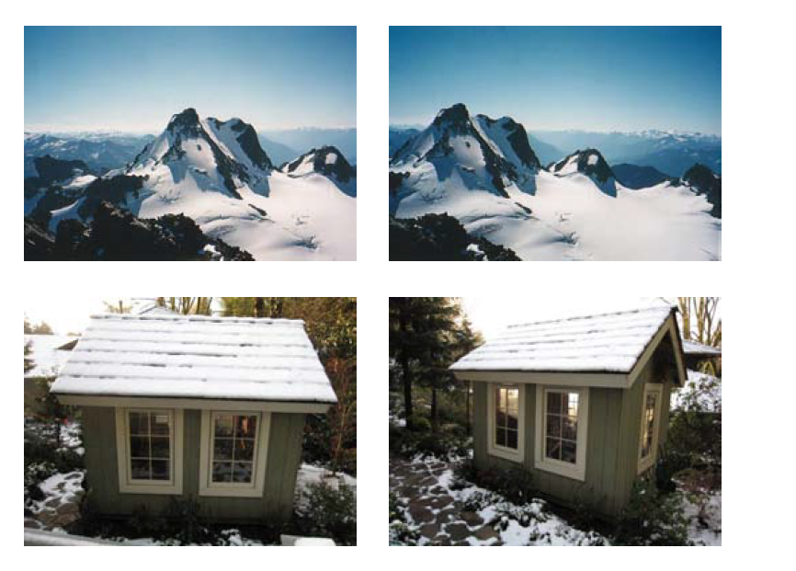
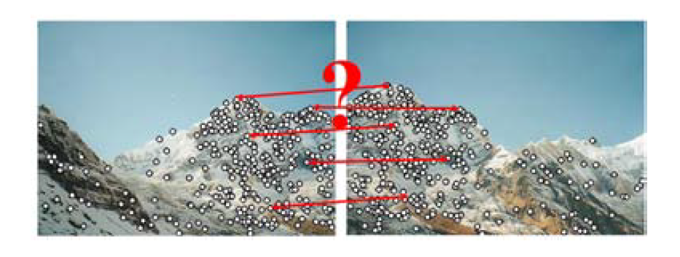
Parameter estimation
How can we match the corresponding points in the different perspective images?
Image source: R Szeliski, Computer Vision: Algorithms and Applications

Slide 3

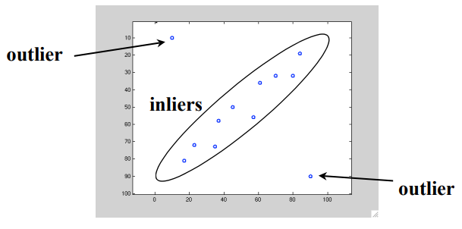
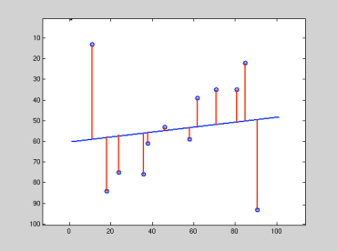
Outliers
Recall: linear regression model
We cannot directly fit the model because of outliers in the data
Robust estimation methods are needed
Image source: http://www.cse.psu.edu/~rtc12/CSE486/lecture15.pdf

Slide 4
Robust Estimation
Two-stage approach:
Classify data points as outliers or inliers
Fit model to inliers only
Example technique: RANSAC (RANdom Sample Consensus)
Iterative method to estimate parameters of a mathematical model (e.g. linear transformation) on potential inliers while ignoring outliers

Slide 5
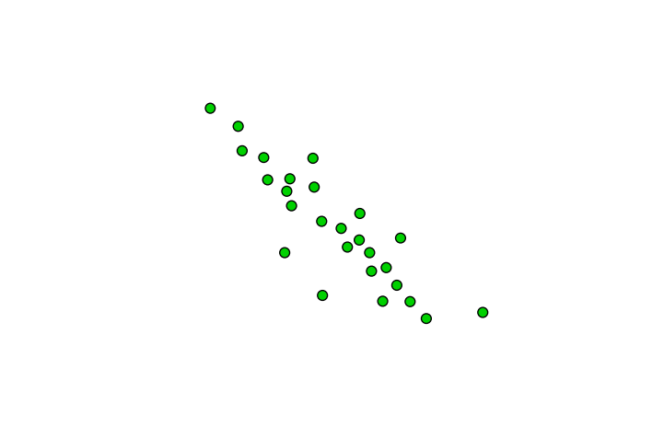
RANSAC procedure
Image source: http://www.cse.psu.edu/~rtc12/CSE486/lecture15.pdf

Slide 6
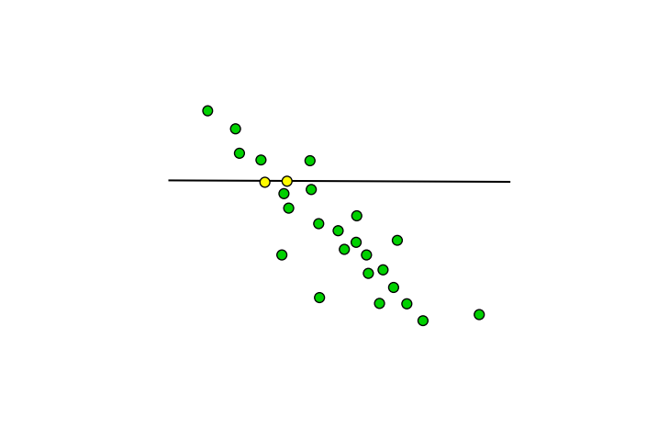
RANSAC procedure
Image source: http://www.cse.psu.edu/~rtc12/CSE486/lecture15.pdf

Slide 7
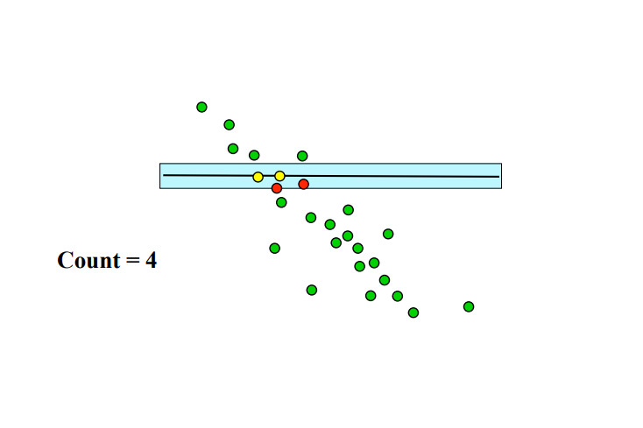
RANSAC procedure
Image source: http://www.cse.psu.edu/~rtc12/CSE486/lecture15.pdf

Slide 8
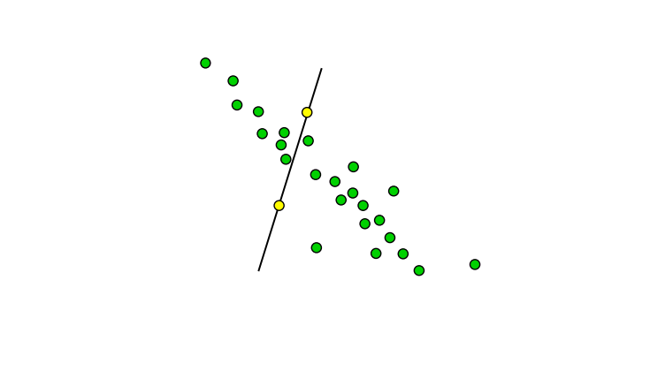
RANSAC procedure
Image source: http://www.cse.psu.edu/~rtc12/CSE486/lecture15.pdf

Slide 9
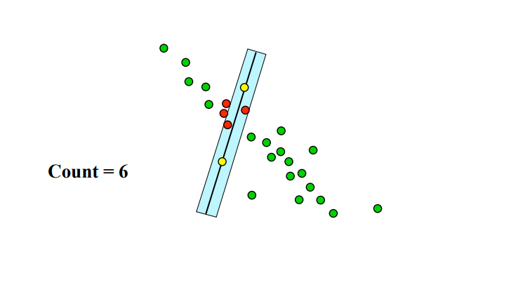
RANSAC procedure
Image source: http://www.cse.psu.edu/~rtc12/CSE486/lecture15.pdf

Slide 10
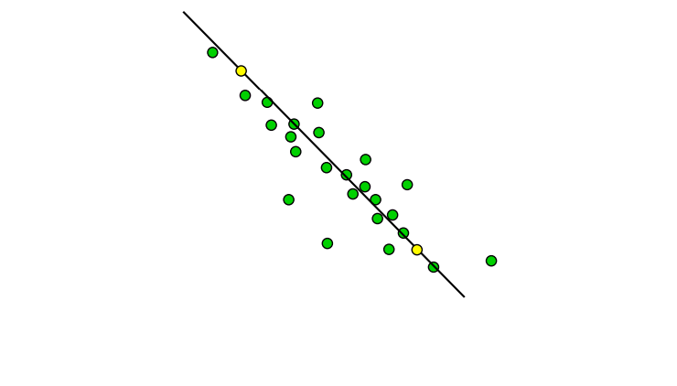
RANSAC procedure
Image source: http://www.cse.psu.edu/~rtc12/CSE486/lecture15.pdf

Slide 11
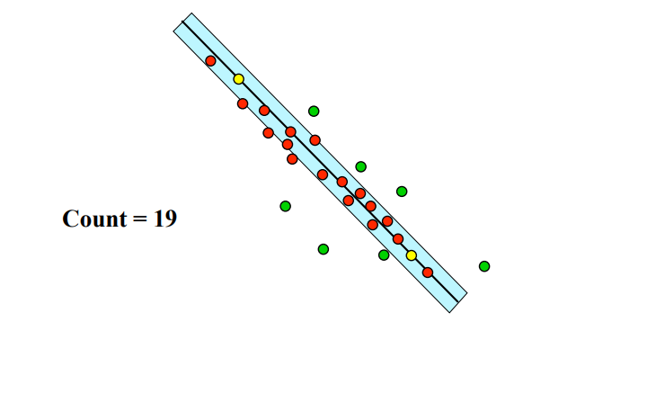
RANSAC procedure
Image source: http://www.cse.psu.edu/~rtc12/CSE486/lecture15.pdf

Slide 12
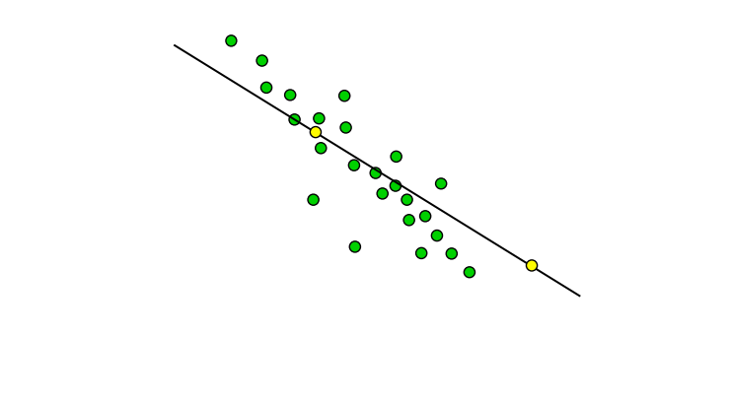
RANSAC procedure
Image source: http://www.cse.psu.edu/~rtc12/CSE486/lecture15.pdf

Slide 13
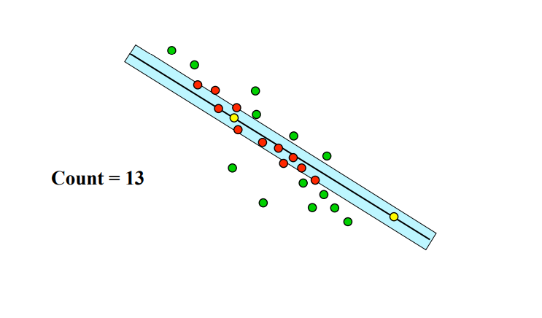
RANSAC procedure
Image source: http://www.cse.psu.edu/~rtc12/CSE486/lecture15.pdf

Slide 14
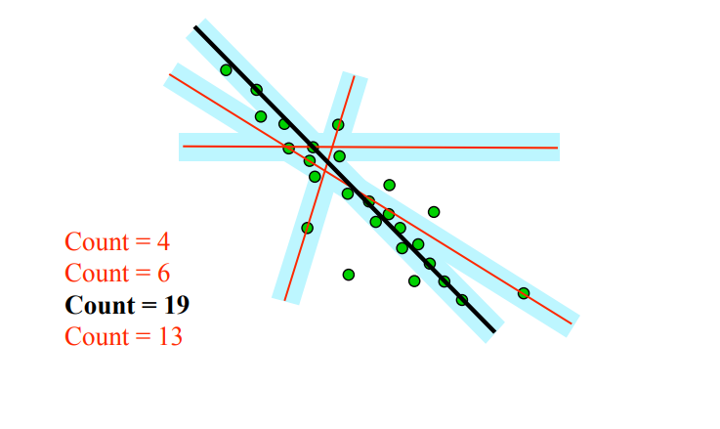
RANSAC procedure
Image source: http://www.cse.psu.edu/~rtc12/CSE486/lecture15.pdf

Slide 15
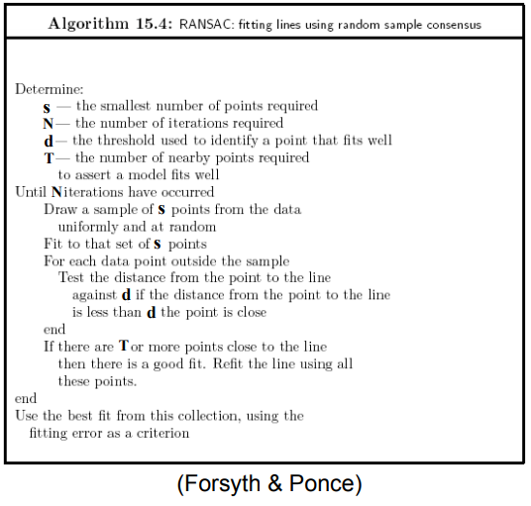
RANSAC
Image source: http://www.cse.psu.edu/~rtc12/CSE486/lecture15.pdf

Slide 16
RANSAC
Image source: http://www.cse.psu.edu/~rtc12/CSE486/lecture15.pdf

Slide 17
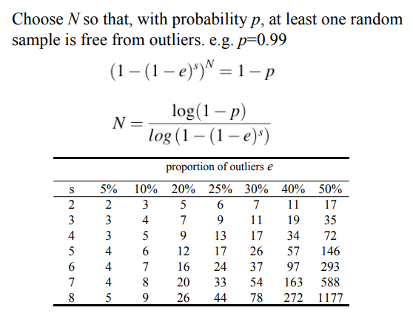
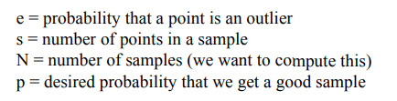
RANSAC
Image source: http://www.cse.psu.edu/~rtc12/CSE486/lecture15.pdf

Slide 18
RANSAC Applications
Align images
Camera stabilization, image stitching
Estimate camera or object movement
object tracking in video
Detect shapes
lane detection for cars

Slide 19
RANSAC: Pros & Cons
Pros
Robust to outliers
Works well for small number of estimated parameters
Cons
Computational complexity increases quickly when the proportion of outliers and number of model parameters increases
Fits only one model at a time
i.e. for multiple fitted lines need to iterate

Slide 20
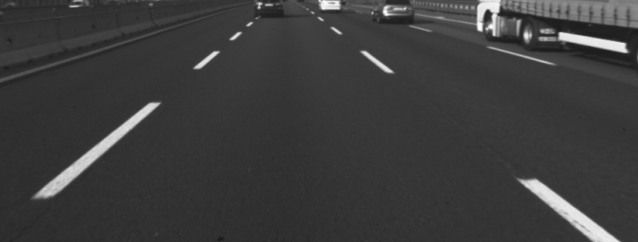
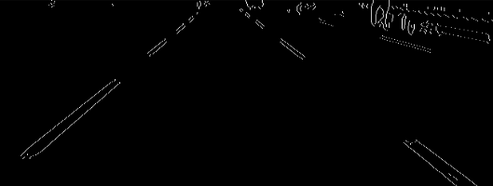
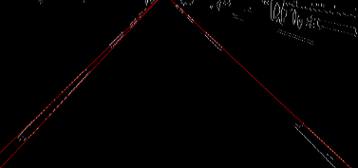
Homework
Preprocess ’lane.png’ such that you can easily find the lanes on
You can use libraries such as cv2
Use RANSAC to find at least one lane and draw a line on it
You can use libraries, except you have to implement RANSAC

Slide 21
Homework
Hint for first part:
Detect edges
Threshold the image
Hint for second part
Treat each pixel as data point
Each lane is its own set of inliers
Everything else should be outlier -> proportion of inliers small
Find the best fitting line through the inliers
Use cv2 functions to draw the line described by two points on the best fitting line

